Slide 1

Plinko in Javascript
Zach Robinson
Thomas schwartz

Slide 2
Goals
Create a small physics engine to power a Plinko game
Puck will fall and bounce with appropriate elasticity against stationary pegs
Puck will be able to fall semi-indeterminately
Puck will be able to land in multiple zones
Points will be awarded based on where the puck rests

Slide 3

Go
Initially started with a programming language called Go (or golang) but found it had little to no support for client-side development.
Go is used largely as a server-side development language, handling server requests and business rules.
The libraries would have needed to be made largely from scratch by both of us. This was not possible in the 4-week deadline.

Slide 4
JavaScript
JavaScript is the premier language for doing client-side development.
We felt this would be better suited to solve the problems of our domain.
We explored prototypes, JavaScript's implementation of object-orientation. We created and manipulated objects through associative arrays.
Two external libraries were used:
p5.js – A library used for drawing on an HTML5 webpage/canvas.
matter.js – A library used for physics-based simulation.
Matter.js was used as reference and backbone for a minimally viable product while we attempted to develop our own engine.

Slide 5
Exploring a Physics Engine
A physics engine intends to modify the behavior of objects by using mathematic formulas to calculate interactions.
The cycle a physics engine looks like this:
An object is created in a view
An object is created in the physics engine that represents that same object
For every frame in a static loop, the physics engine applies its effects on every object in its world and updates/calculates the new position of each object.
After the calculation, the object array in the view/canvas asks the physics engine what the new position is of each object, and then redraws the view with the updated information.
The result is an apparent physical simulation.

Slide 6
Exploring a Physics Engine
What types of effects can a physics engine calculate?
Gravity
Velocity
Collision (when objects collide)
Mass
Conserved momentum on each object after a collision (considering mass and restitution)
Restitution - how elastic an object is
Friction
Air resistance
Any contrived global or local effect

Slide 7
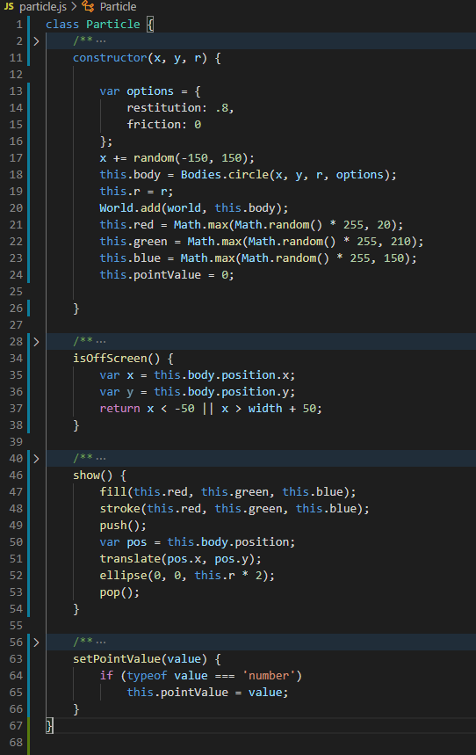
Particle
Constructor takes in x and y position as well as a radius. The options variable is an associative array used to construct the object in the physics engine world.
Randomly generate a color which is used in show() method.
setPointValue will be used to calculate score.

Slide 8
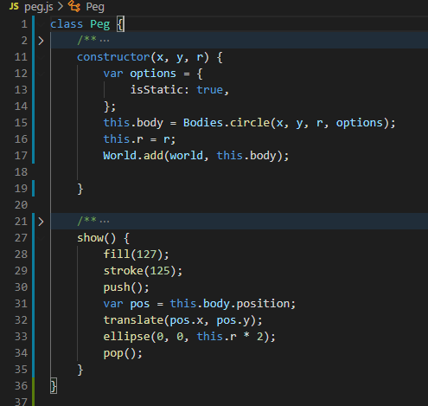
Peg
Constructor is similar to the particle.
Within the show function, the push() and pop() are needed so keep the display array clean so that future objects will be created at the position given in the constructor, and not manipulated by previous peg objects.

Slide 9
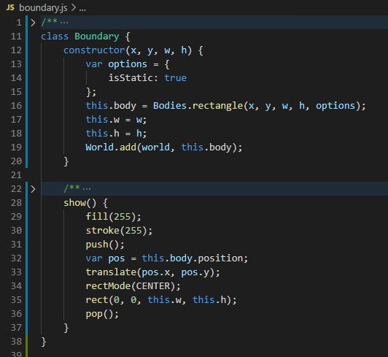
Boundary
Constructor takes x and y position as well as a width and height.
These are used so that the created pucks will not leave the canvas area.
Boundary objects are also used to create the point zones at the bottom of the canvas.

Slide 10
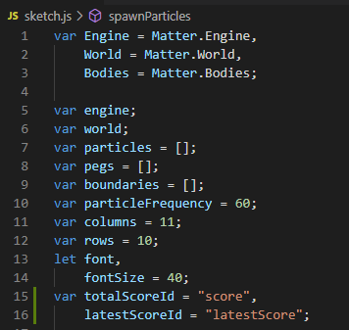
Main: globals
These are the global variables used to manipulate the Plinko game.
1-3 Ease of access variables
7-9 Object arrays for drawing
10-12 Allows for game display manipulations
13-16 Visual Manipulation

Slide 11
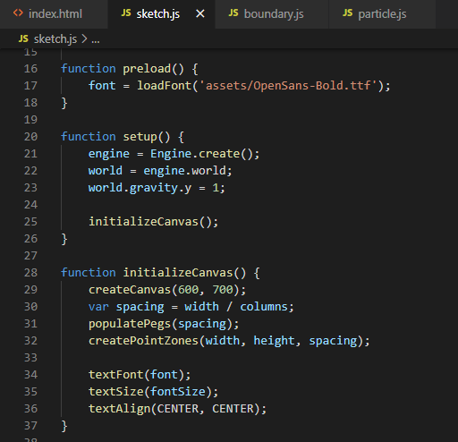
Main: initialize
Creates the engine, assigns its world to a global variable.
We refactor initializeCanvas() so that it can be called upon every redraw.
Create a new canvas which creates the width and height variables. Designate spacing for pegs, then populate the pegs and the boundaries.

Slide 12
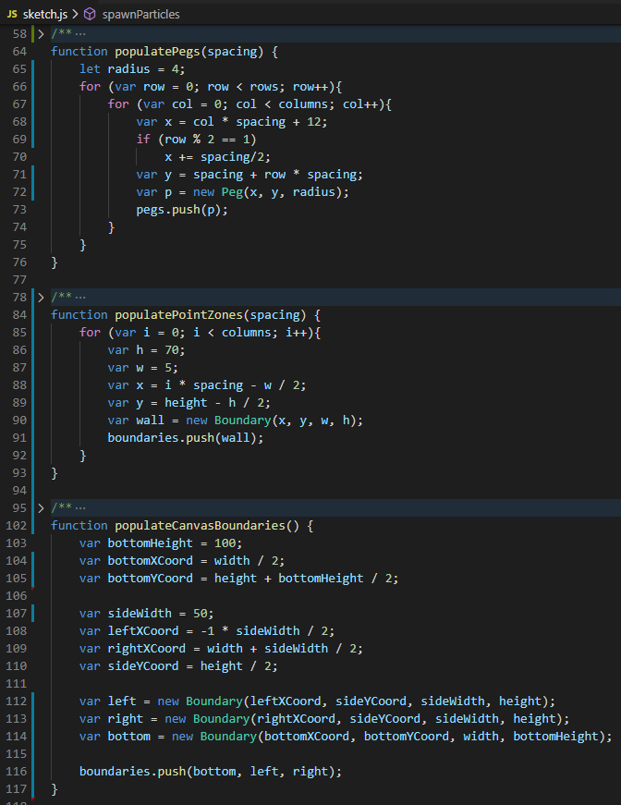
Main: populate objects
Populate the pegs using a nested for loop structure. 69-70 Offsets every 2nd row of pegs.
Populate the zones in which particles will rest.
Populate the boundaries of the canvas so that particles will remain within the game area.

Slide 13
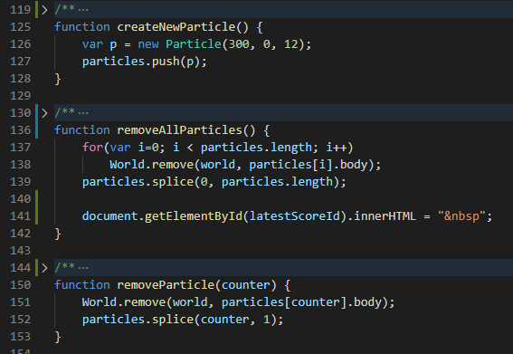
Main: create particles
Create a particle by calling the constructor and then adding it to the global object array.
Remove all particles from the world (if we want to reset the game).
Remove a single particle from the world (if it somehow leaves the boundaries of the game, we don’t want to calculate its position anymore).

Slide 14
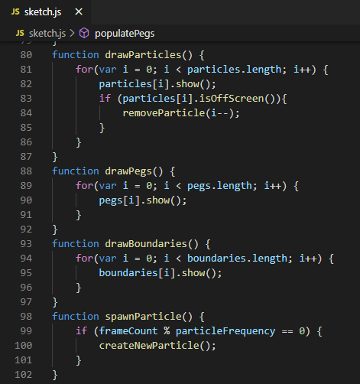
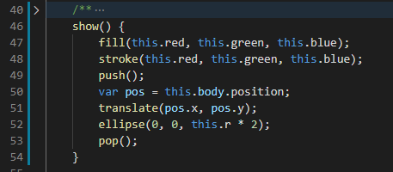
Main: draw objects
For each object in it’s corresponding global object array, run the objects show method
47-48 – Colors 51-52 – Creates circle at 0,0 then translates to correct position.

Slide 15
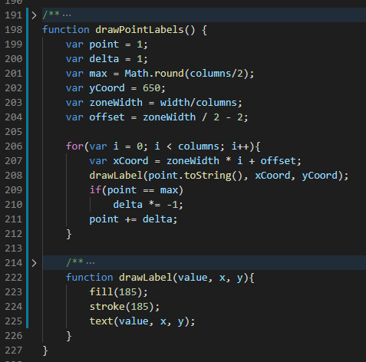
Main: draw labels
Use a loop to calculate point values. Line 209-210 will oscillate the point value from 1 to max and back down again.
Inner function drawLabel() will draw the given point value at a particular x and y coordinate.

Slide 16
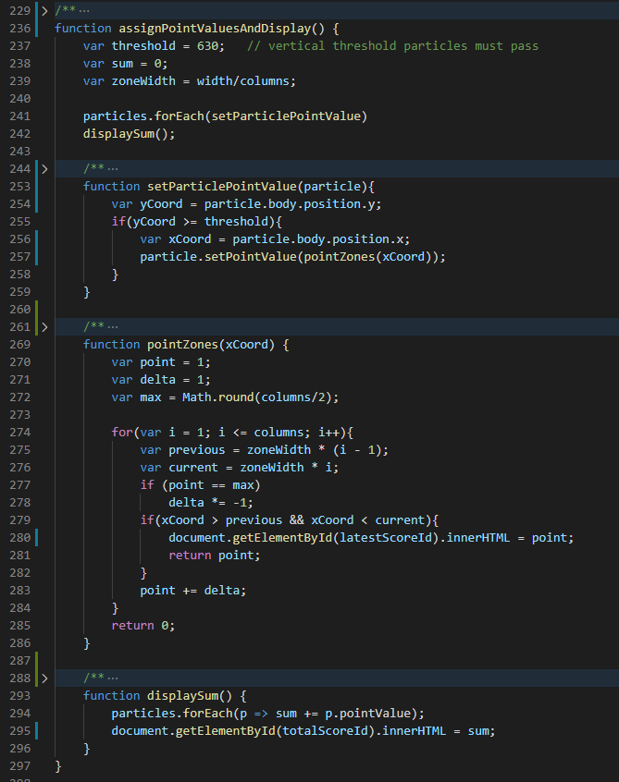
Main: assign points
If particle passes past threshold, set it’s pointValue property.
Determine pointValue by checking its X position using the oscillating loop structure from previous slide.
Foreach particle object in array, look at it’s pointValue property and display the overall sum on index.html

Slide 17
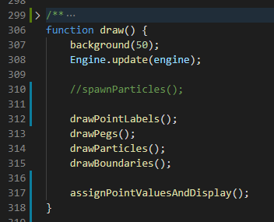
Main: draw loop
On every frame, update the engine. This calculates and updates the position for all objects.
Redraw all displayable objects on the screen including, labels, pegs, particles, and boundaries.
Finally, update point values and display on main page.

Slide 18
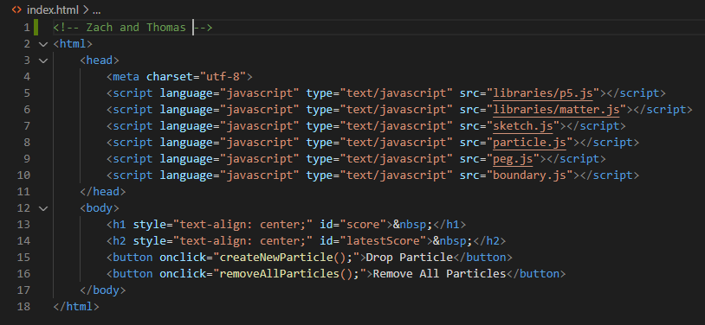
index.html
Imports the javascript files into the html document.
Create some buttons to interact with the javascript methods that were created in the sketch.js file.

Slide 19
Demo

